Slide 1

Branch Transformation

Slide 2
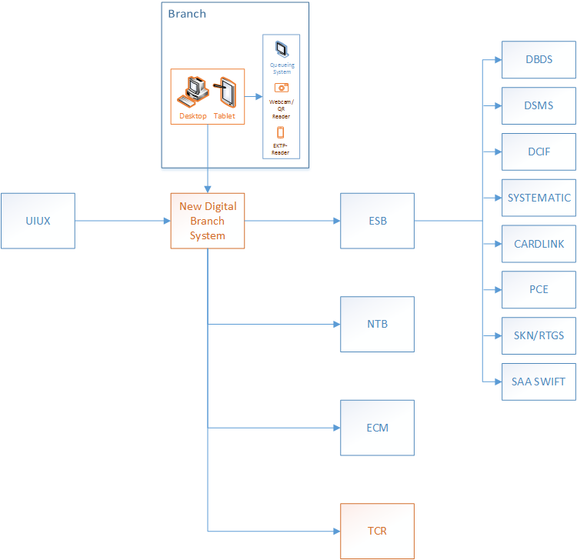
Digital Branch System
Application Architecture

Slide 3
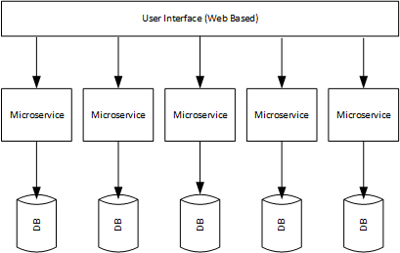
Digital Branch System
Application Architecture
Teknologi yg digunakan pada masing-masing layer?
UI: Progressive Web App ?? NodeJS, Docker , OS: Centos 8.1.19
Microservice: Spring Boot, Tomcat, Running on Docker, Kubernate, OS: Centos 8.1.19
DB : Oracle 19c, Red Hat 7.5 (Cluster)
DEV: Mengunakan Azure Cloud

Slide 4
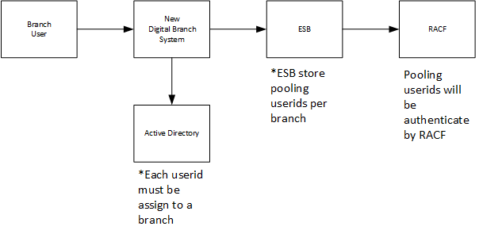
User Authentication
Using Active Directory

Slide 5
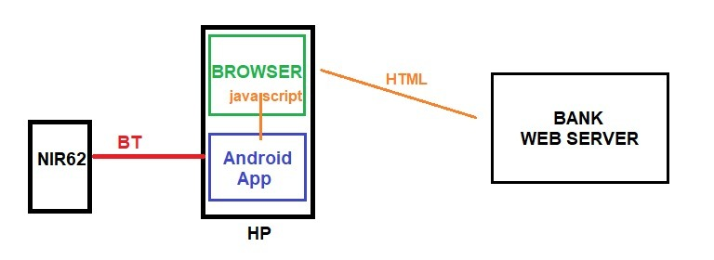
EKTP Reader
Integration

Slide 6
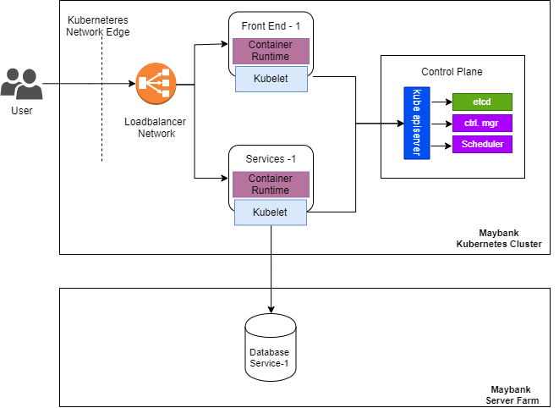
Application Architecture
With Kubernates

Slide 7
KUBERNATES
KUBERNATES
UI Service 1
Service 1
Eureka
F5
UI Service N
Service N

Slide 8
BIOMETRICS
Technology Stack
Persentation Technology
Persentation Technology
CSS
JavaScript
HTML
CSS
JavaScript
Rest API
JMS
Application Server
Application Server
EZMCOM MFA Application Server 4.2.3
IBM WebSphere
Rest
Development/Application Platforms
Development/Application Platforms
JavaScript
Java EE
SOAP
Integration Services
Integration Services
Framework System
Framework System
Sencha extJS
WSDL
Database System
Database System
IBM DB2
Microsot SQL Server
ORACLE 12
Operating System
Operating System
Windows Server 2012 R2
AIX
Red Hat Enterprise Linux Server release 7.4

Slide 9
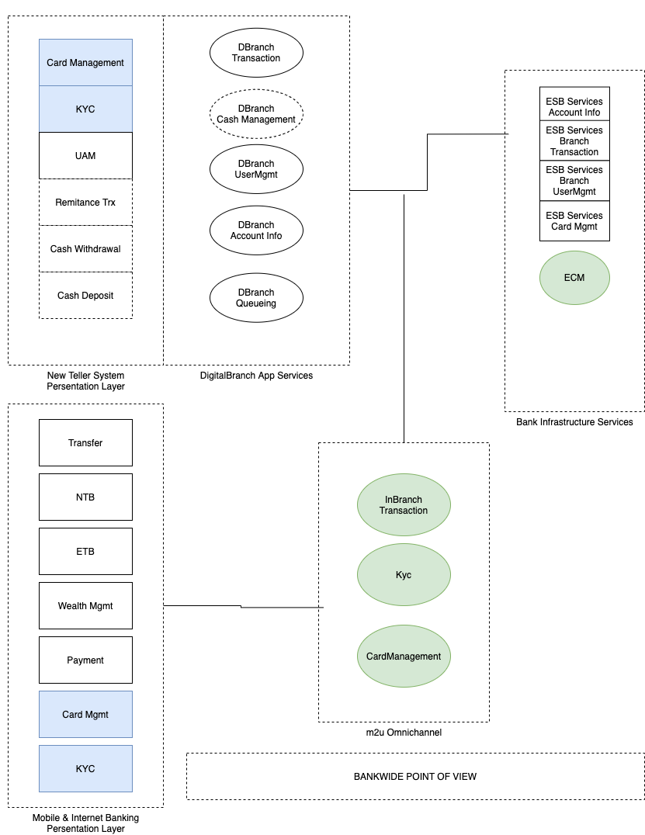
Bankwide Architecture Point Of View

Slide 10
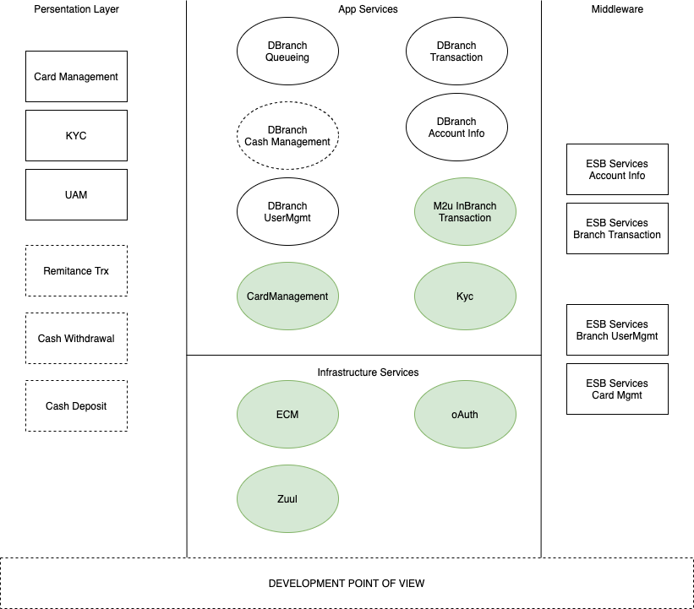
Development Architecture Point Of View

